Slide 1
CHAPTER 8: WAREHOUSE MANAGEMENT

Slide 2
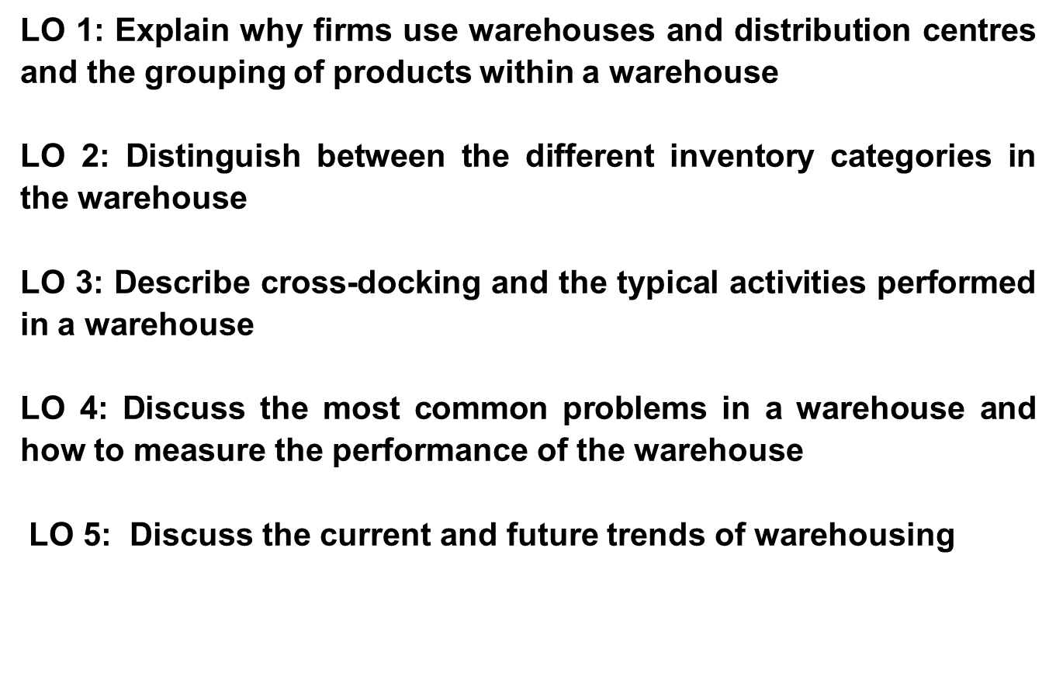
Learning outcomes for Chapter 8

Slide 3
The role of warehousing
Warehousing performs an essential role in the supply chain, from inbound raw materials warehousing, to outbound finished goods warehousing post-production, and any forward warehousing activities closer to the final place of consumption in terms of the customer - either performed by network depots or large distribution centres.

Slide 4
Warehousing defined
Any system of storing products at any point in the logistics system from the point of origin of goods (raw material warehouse) through production (work-in-process or production warehouse) to the point of consumption (finished goods warehouse or distribution centre).
Warehouse and distribution centre (DC) are used interchangeably although a DC holds inventory at the downstream end of the supply chain.
Warehouses refer to places where raw materials, work-in-process goods and finished goods are stored.

Slide 5
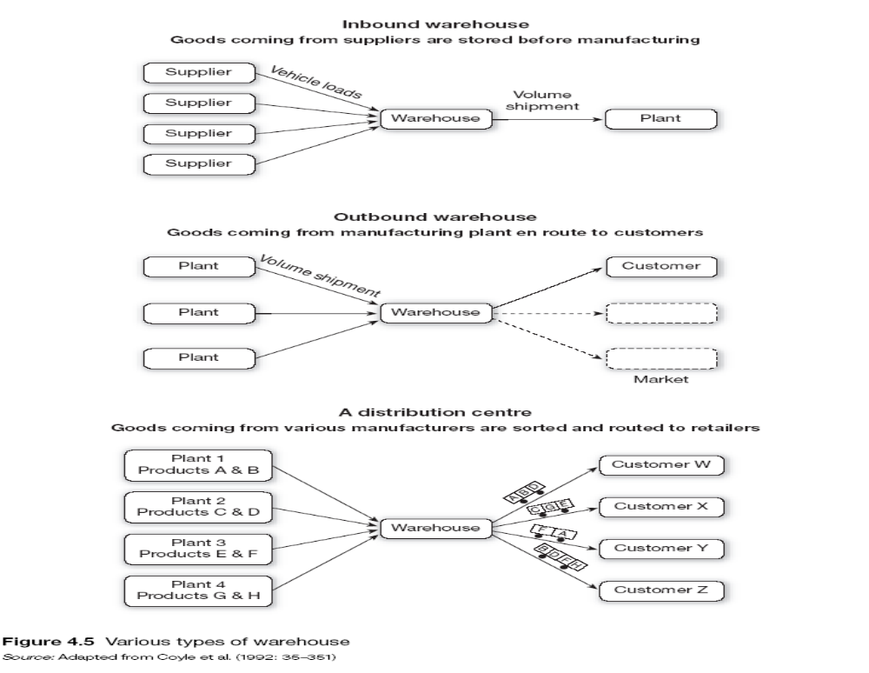
Type of Warehouses:

Slide 6
Why firms use warehouses and distribution centres
To achieve economies of scale
To achieve production economies
To take advantage of quantity purchasing discounts and forward buys
To maintain a source of supply
To support firm's customer service policies
To meet changing market conditions
To help overcome the time and space (distance) gap that exists between producer and the end consumer
To accomplish least total cost logistics
To service the needs of a firm more effectively
To support the just-in-time programmes of suppliers
To keep a steady flow of supply of the product
To enable efficient "last mile" logistics
To help provide a level of customer satisfaction and service
To serve as a link between the supplier and the producer

Slide 7
Purpose of warehousing
Movement:
Receiving activity
Transfer
Order selection
Shipping
Storage:
Temporary basis
Semi-permanent basis
Information transfer:
Inventory levels
Throughput levels
Stock-keeping locations
Customer data

Slide 8
Product groupings within the warehouse
Goods can be grouped according to the following three methods:
Compatibility - in terms of similarity
  Nike shoes : Men, Woman, Kids
Complementary - how often products are ordered together
  Golf clubs, golf shoes, golf bags etc.
Popularity - dependent on turnover rates or demand rates
  Samsung S10, Iphone 11 etc.

Slide 9
Categorisation of inventory within the warehouse
Goods can be categorised according to the following methods:
According to Demand Frequency
  Customers both internal and external, want items from the warehouse at different times of the year.
  Goods are shelved according to the demand for the product.

Slide 10
Categorisation of inventory within the warehouse
Goods can be categorised according to the following methods:
According to Pick Destination
  Goods can be stored and categorised based on going to the same destination.

Slide 11
Categorisation of inventory within the warehouse
Goods can be categorised according to the following methods:
According to special storage requirements:
- Hazardous: Radioactive materials, poisonous materials etc.
- Perishable: Diary, Meat, Flowers etc.

Slide 12
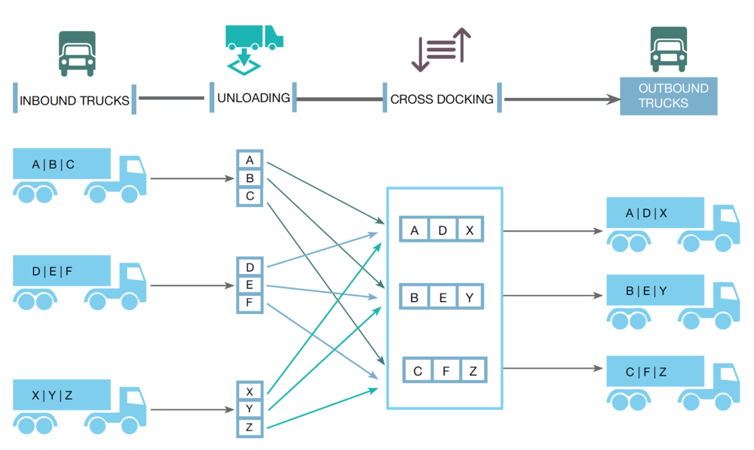
CROSS-DOCKING

Slide 13
Typical activities performed in a warehouse
The major functions of movement, storage and information transfer give rise to the following activities:
The receiving process
Placing
Storage
Replenishment
Order picking
Checking
Packing and marking
Staging and consolidation
Loading and shipping
Clerical or administration function
Housekeeping
Maintenance
Inventory management
Value-added services
Assembly functions
Create or break bulk

Slide 14
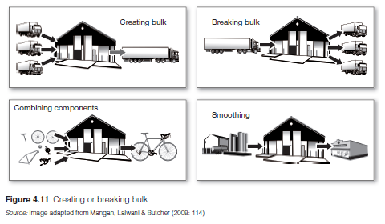
Create or break bulk

Slide 15
Most common warehousing problems
Storage space utilisation
Product handling problems
Warehousing equipment problems
Labour intensity associated with warehousing
Information gaps between warehousing and manufacturing or retailing
Costing and budgeting is often difficult

Slide 16
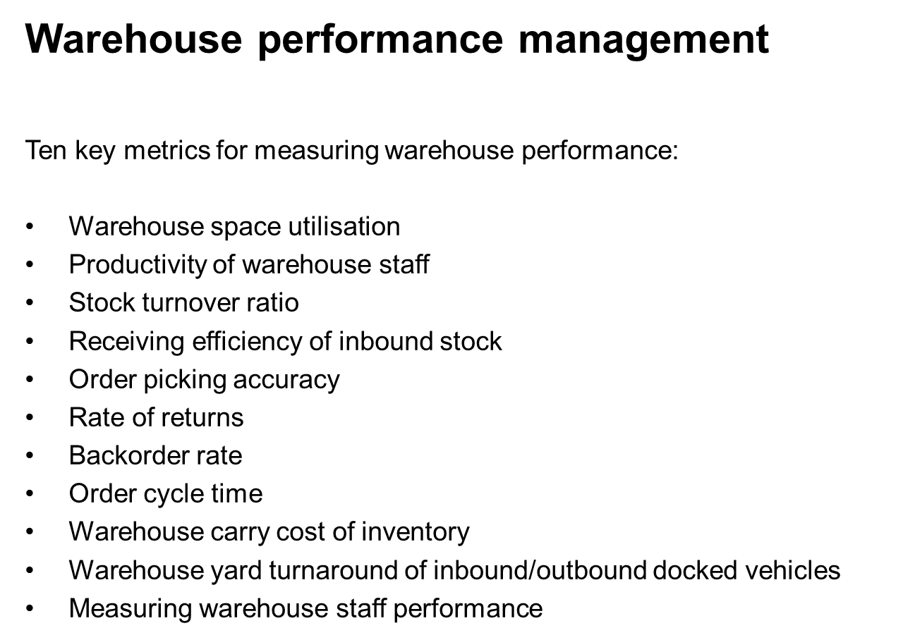

Slide 17
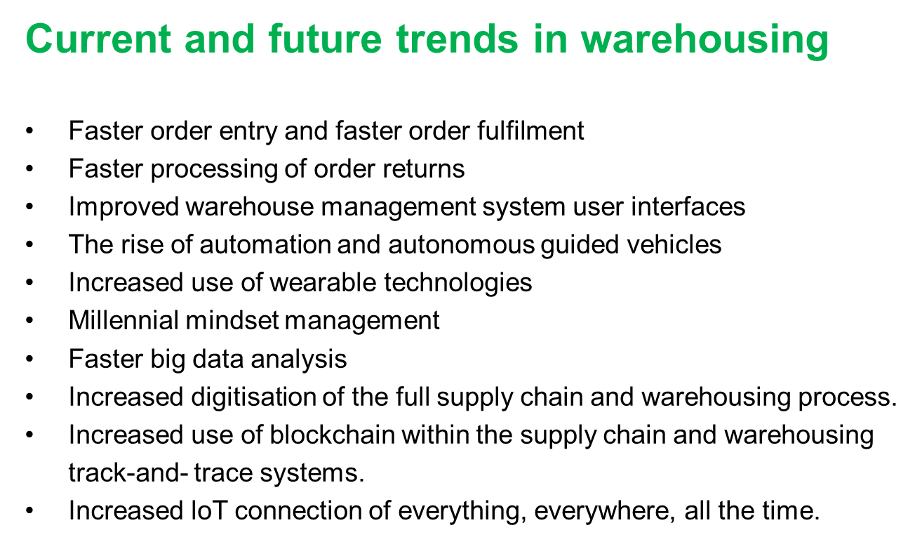

Slide 18
Sections to leave out:
Section 8.4: Warehouse design and layout
Section 8.10: Organising for warehouse management
Section 8.12: Materials handling equipment

